Slide 1

Fine-Tuning and Maske Language Models

Slide 2
Contents
Introduction to Fine-Tuning
Pre-Trained Models for Fine-Tuning
Processing of Fine-Tuning
Benefits of Fine-Tuning
Limitations
Masked Language Models (MLM)
MLM Objective and Architecture
Downstream Tasks with MLMs

Slide 3
Introduction to Fine-Tuning
Concept
  Fine-tuning refers to the process of taking a pre-trained model, which has learned general language features from a large dataset, and adapting it to perform specific tasks or improve performance on specific datasets.
  It involves adjusting the model's parameters based on the characteristics of the target task or data, while retaining the valuable knowledge acquired during pre-training.

Slide 4
Introduction to Fine-Tuning
Leveraging Pre-trained Knowledge
  Pre-trained models have already learned rich linguistic patterns, semantic relationships, and contextual understanding from a diverse range of text data.
  Fine-tuning capitalizes on this extensive knowledge, enabling the model to generalize better to specific tasks with a smaller amount of task-specific data.

Slide 5
Introduction to Fine-Tuning
Fine-Tuning in the Context of Pre-trained Language Models
  In the context of pre-trained language models like BERT, GPT-3, and others, fine-tuning involves taking the model, often with its original architecture and parameters, and adapting it to perform tasks like text classification, named entity recognition, sentiment analysis, machine translation, and more.

Slide 6
Introduction to Fine-Tuning
The fine-tuning process generally involves the following steps
  Task-Specific Data
    Obtain a dataset that is specific to the task you want the pre-trained model to perform. This dataset is used for fine-tuning.
  Adjusting Parameters
    Initialize the pre-trained model's parameters with the learned weights and then update them using the task-specific dataset. The objective is to fine-tune the model to the nuances of the task while preserving its general language understanding.
  Optimization
    Train the model on the task-specific data using optimization techniques like gradient descent, adjusting the parameters to minimize task-specific loss.
  Evaluation
    After fine-tuning, evaluate the model's performance on validation or test data to see how well it performs on the target task.

Slide 7
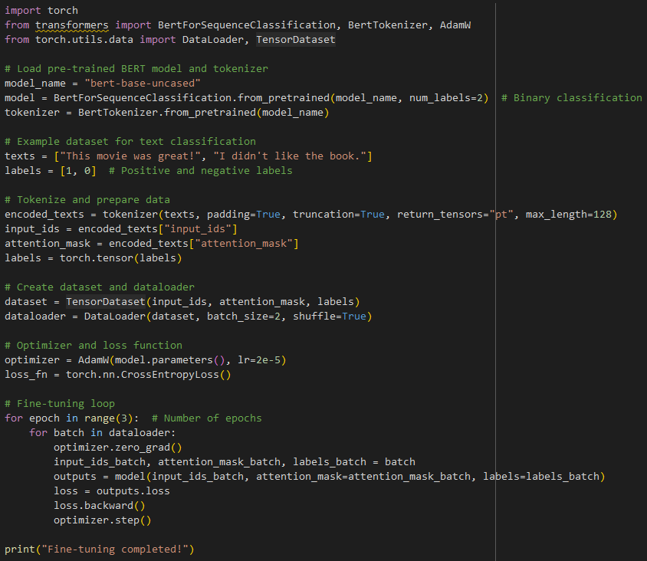
Example
Example of fine-tuning a pre-trained BERT model for text classification using the Hugging Face Transformers library
In this example:
We load a pre-trained BERT model with a binary classification head.
We prepare an example dataset with text samples and corresponding labels.
We tokenize the texts using the tokenizer and create input tensors.
We create a dataset and dataloader for batching.
We set up an optimizer (AdamW) and a loss function (CrossEntropyLoss).
We run a fine-tuning loop over the dataset using mini-batches.

Slide 8
Pre-Trained Models for Fine-Tuning
Importance of Pre-trained Language Models in NLP Tasks
  Pre-trained language models have become pivotal in the field of Natural Language Processing (NLP) due to their ability to significantly improve the performance of various tasks.
  They bring two main advantages:
  Linguistic Understanding
    Pre-trained models have learned intricate linguistic patterns, semantic relationships, and contextual nuances from vast amounts of text data. This understanding of language enables them to better grasp the complexities of human communication.
  Transfer Learning
    Pre-trained models serve as strong starting points for fine-tuning on specific tasks. They provide a foundation of general language knowledge that can be adapted to different tasks, reducing the need for massive task-specific datasets.

Slide 9
Pre-Trained Models for Fine-Tuning
Capturing Linguistic Patterns and Relationships
  Pre-trained models capture linguistic patterns and relationships by training on diverse and extensive text corpora.
  They learn the contextual meanings of words, syntactic structures, idiomatic expressions, synonyms, antonyms, and other intricacies of language.
  This acquired knowledge is encapsulated in their hidden layers, which encode rich semantic representations.

Slide 10
Pre-Trained Models for Fine-Tuning
Models as Starting Points for Fine-Tuning
  Models like BERT (Bidirectional Encoder Representations from Transformers) and GPT-3 (Generative Pre-trained Transformer 3) are two prominent examples that serve as robust starting points for fine-tuning.
  BERT
    It captures context from both directions in a sentence, enhancing its ability to understand meaning and context.
    BERT's pre-trained weights can be fine-tuned for various tasks, such as text classification, question answering, and named entity recognition.
  GPT-3
    With an immense number of parameters, GPT-3 generates coherent text and answers based on prompts.
    While not typically fine-tuned due to its scale, it showcases the power of pre-trained models for generating human-like language..

Slide 11
Processing of Fine-Tuning
Fine-tuning pre-trained language models involves adapting a pre-trained model to a specific task. Here's a general overview of the process
Choose a Pre-trained Model Architecture
  Select a pre-trained model that suits your task and matches the type of data you have. Popular choices include BERT, GPT-2, RoBERTa, and more.
Define a Task-Specific Dataset and Labels
  Gather or create a dataset that is specific to your task. This dataset should include input text data and corresponding labels or annotations for training and evaluation.
Modify the Model's Architecture Slightly
  Tailor the architecture of the pre-trained model to the specific task. This might involve adding task-specific layers or modifying the output structure to match the number of classes or labels in your task.

Slide 12
Processing of Fine-Tuning
Fine-tuning pre-trained language models involves adapting a pre-trained model to a specific task. Here's a general overview of the process
Fine-Tune the Model on the Task-Specific Data:
  The process of fine-tuning involves training the modified model on your task-specific dataset. The general steps include:
    Initialize Weights: Initialize the model's weights with the pre-trained values from the chosen architecture.
    Optimization: Use an optimization algorithm (e.g., gradient descent) to adjust the model's weights based on the task-specific dataset. Update the model's parameters iteratively to minimize the loss function.
    Backpropagation: Calculate gradients of the loss with respect to the model's parameters, and update the parameters accordingly to minimize the loss.
Evaluate and Adjust Hyperparameters if Needed:
  After fine-tuning, evaluate the model's performance on a separate validation or test dataset. Depending on the results, you might need to adjust hyperparameters (e.g., learning rate, batch size) or other aspects of the training process to optimize performance.

Slide 13
Benefits of Fine-Tuning
Faster Convergence
  Fine-tuning starts with pre-trained weights that already possess a good understanding of language. This initial knowledge allows the model to converge faster during training, as it doesn't need to learn everything from scratch.
Reduced Computational Resources
  Training a model from scratch can be computationally expensive and time-consuming. Fine-tuning takes advantage of the pre-trained weights, saving valuable computational resources and enabling quicker experimentation.
Improved Performance on Specific Tasks
  Fine-tuning allows pre-trained models to adapt to specific tasks, often resulting in improved performance. The model leverages its general language understanding and tailors it to the nuances of the task, often achieving state-of-the-art results.
Lower Data Requirements
  Fine-tuning requires less task-specific labeled data compared to training a model from the ground up. This is particularly valuable when labeled data for a specific task is limited or expensive to acquire.

Slide 14
Benefits of Fine-Tuning
Efficient Transfer of Knowledge
  Fine-tuning encapsulates the knowledge acquired from a vast amount of diverse text data. It enables the model to transfer this knowledge to new tasks, accelerating the learning process for those tasks.
Scalability
  Fine-tuning is scalable, allowing the same pre-trained model to be fine-tuned on different tasks, domains, or languages, promoting reuse and adaptation.
Versatility
  Pre-trained models can be fine-tuned for various NLP tasks such as classification, summarization, question answering, and more. This versatility makes them a powerful tool in the NLP practitioner's toolkit.
Adaptation to Domain-Specific Data
  Fine-tuning enables models to adapt to domain-specific data, such as legal, medical, or technical domains, where specialized language understanding is crucial.

Slide 15
Limitations
Data Quality and Domain Mismatch
  Fine-tuning depends heavily on the quality and relevance of the task-specific data. If the task data is of poor quality or doesn't match the distribution of the pre-training data, the model's performance might not improve significantly.
Overfitting to Task-Specific Data
  Fine-tuning can lead to overfitting, especially if the task-specific dataset is small. The model may learn to memorize the training examples rather than capturing general patterns, resulting in poor generalization to new data.
Balance between Freezing and Updating Layers
  Deciding which layers to freeze (keep fixed) and which to update during fine-tuning is crucial. Lower layers tend to capture more general linguistic features, while higher layers capture task-specific nuances. Striking the right balance ensures the model benefits from pre-training while adapting to the task.

Slide 16
Limitations
Catastrophic Forgetting
  Fine-tuning could cause the model to forget some of its pre-trained knowledge, particularly if the task-specific data is very different from the pre-training data. Careful regularization and training techniques are needed to mitigate this.
Choosing Hyperparameters
  Selecting the right hyperparameters (learning rate, batch size, regularization) is important. Hyperparameters that worked well for pre-training might not be optimal for fine-tuning, and improper choices can impact convergence and performance.
Label Noise and Bias
  If the task-specific labels have noise or bias, the model can learn incorrect associations. This could lead to biased predictions or suboptimal results.

Slide 17
Limitations
Sequential vs. Token-Level Tasks
  Models pre-trained for token-level tasks (like masked language modeling) might need adaptation for sequential tasks (like text generation). Consider modifications like causal masking and tailored training setups.
Transferability to Unseen Tasks
  Fine-tuning might not always transfer smoothly to tasks that are significantly different from the pre-training objectives. The model's performance on such tasks might not be as high as on closely related tasks.
Regularization Strategies
  Regularization techniques, such as dropout and weight decay, may need adjustment for fine-tuning. Too much regularization could hinder learning, while too little could lead to overfitting.
Evaluation and Validation Set
  Careful selection of the evaluation and validation datasets is important to gauge the model's generalization and track its progress during fine-tuning.

Slide 18
Masked Language Models (MLM)
Masked Language Models (MLM) is a specific pre-training task used to train models like BERT (Bidirectional Encoder Representations from Transformers).
It revolves around the idea of masking out (hiding) certain words in a sentence and then predicting those masked words based on the surrounding context.

Slide 19
Masked Language Models (MLM)
Predicting Masked Words Using Context
  In the MLM task, a portion of the input text is randomly chosen, and some of its words are replaced with a special [MASK] token.
  The model's objective is to predict the original words that were masked out, given the context of the surrounding words.
  By training on this task, the model learns to understand contextual relationships and meaning in both directions (left and right) within a sentence.

Slide 20
Masked Language Models (MLM)
BERT as a Popular MLM Example
  BERT is a groundbreaking pre-trained model that excels at various NLP tasks, and it's an example of an MLM.
  During its pre-training phase, BERT learns by predicting the masked words in sentences.
  This encourages the model to capture deep contextual understanding, as it must rely on the context of surrounding words to accurately predict the masked word.

Slide 21
MLM Objective and Architecture
MLM objective involves two main steps
  Masking Words
    A random portion of the input sentence is selected, and some of its words are masked by replacing them with a special [MASK] token. This creates gaps in the sentence.
  Predicting Masked Words
    The model's task is to predict the original words that were masked out, given the context of the surrounding words. The model encodes the context and generates predictions for the masked words.

Slide 22
MLM Objective and Architecture
Architecture of MLM Models (e.g., BERT)
  Models like BERT use a transformer-based architecture for MLM pre-training. The architecture consists of multiple encoder layers. Each layer consists of two sub-layers:
  Self-Attention Mechanism
    In this sub-layer, each word in the input sentence attends to all other words to capture contextual relationships. The self-attention mechanism enables the model to weigh the importance of other words in understanding the meaning of a word.
  Position-wise Feedforward Neural Network
    After obtaining the context-based representations from the self-attention sub-layer, each word's representation is passed through a position-wise feedforward neural network. This network learns to capture complex relationships between words and their surrounding context.

Slide 23
MLM Objective and Architecture
Masked Language Model Training Process
  Input Encoding
    The input sentence is tokenized and converted into word embeddings, which are then passed through the transformer's encoder layers.
  Masking
    A portion of the words in the input sentence is masked out by replacing them with [MASK] tokens.
  Forward Pass
    The masked sentence embeddings are processed through the encoder layers. The self-attention mechanism captures contextual relationships.
  Prediction
    The model predicts the original words corresponding to the [MASK] tokens in the masked sentence.
  Loss Calculation
    The model's predictions are compared with the actual masked words, and a loss is calculated. The goal is to minimize this loss during training.

Slide 24
Downstream Tasks with MLMs
Sentence Classification
  For tasks like sentiment analysis or text categorization, the final [CLS] token representation from BERT's pre-trained model can be used as an input to a classification layer. The model can be fine-tuned on labeled data for these tasks. The [CLS] token learns to encapsulate the overall understanding of the sentence and can serve as a strong starting point for classification tasks.
Named Entity Recognition (NER)
  For NER tasks, the fine-tuning process involves providing the model with labeled data where entities are tagged. The model learns to recognize and label entities (such as names, dates, organizations) by leveraging its contextual understanding to identify boundaries and classify entities within sentences.

Slide 25
Downstream Tasks with MLMs
Machine Translation
  In machine translation, the MLM can be fine-tuned by training it on paired sentences in the source and target languages. By conditioning the model on the source sentence and guiding it to generate the target sentence, fine-tuning adapts the model's language understanding for translation tasks.
Question Answering
  For question answering tasks, the model is fine-tuned on data that pairs questions with corresponding answers or answer spans. The MLM's contextual understanding aids in identifying the relevant parts of the text to answer questions accurately.

Slide 26
Practice
Instructions
  In this assignment, you'll explore and work with masked language models using the Hugging Face Transformers library.
  You'll understand how they're trained and implement a simple example.
Tasks
  Task 1: Understanding Masked Language Models
    Research and explain the concept of masked language models (MLM) in the context of natural language processing.
    Describe how MLMs are trained and what they learn from the masking process.
  Task 2: Implementing a Simple Masked Language Model
    Choose a pre-trained masked language model (e.g., BERT) from the Hugging Face Transformers library.
    Select a sentence from a text corpus that you'll use for the masking task.
    Tokenize the sentence using the chosen model's tokenizer.
    Implement a function to randomly mask a certain percentage of tokens in the tokenized sentence.
    Predict the masked tokens using the loaded MLM and compare them with the original tokens.
    Calculate and report the accuracy of the MLM in predicting the masked tokens.

Slide 27
Q & A

